Slide 1
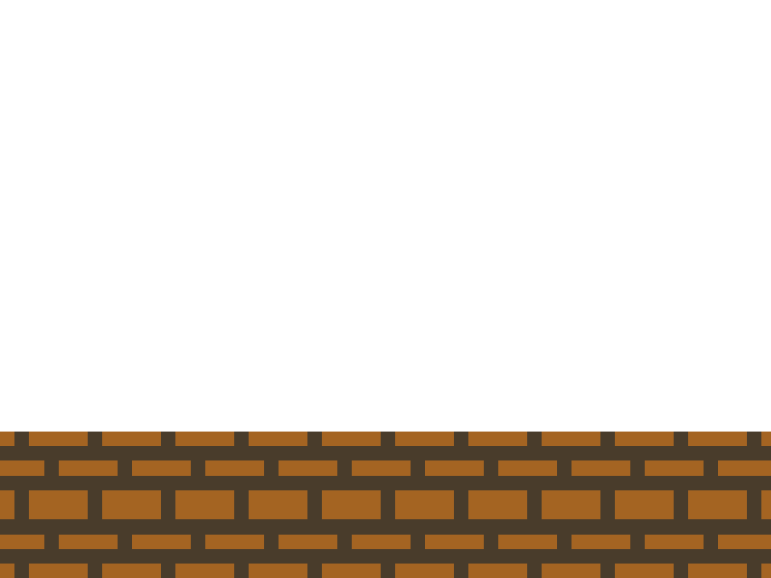
Automatic Game Script Generation
by Ahmed Abdel Samea Khalifa
Supervised by Prof. Magda Fayek

Slide 2


Agenda
Introduction
Background
Level Generation
  Literature Review
  Methodology
  Results
Rule Generation
  Literature Review
  Methodology
  Results
Conclusion & Future Work

Slide 3
Introduction

Slide 4
Introduction
Aim
  Assessing Puzzle Levels
  Generate General Puzzle Levels
  Generate Puzzle Rules
Motivation
  Reduce Time and Cost
  Be more Creative
  Understanding Human Creativity Process
Automatic Puzzle Level Generation: A General Approach using a Description Language - Ahmed Khalifa and Magda Fayek - Accepted in Computational Creativity & Games Workshop 2015

Slide 5
Background

Slide 6
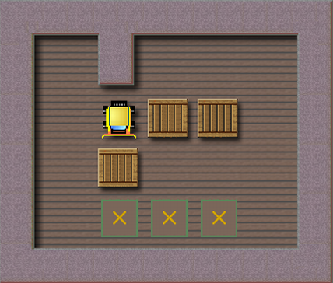
Background
Puzzle Games
Procedural Content Generation (PCG)
  Graphics, Music, Levels, Rules, ...etc
Video Game Description Language (VGDL)

Slide 7
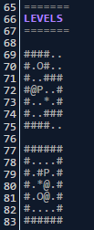
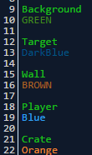



Background
Puzzle Script
  Objects
  CollisionLayers
  Rules
  WinConditions
  Levels

Slide 8
Level Generation
Literature Review

Slide 9
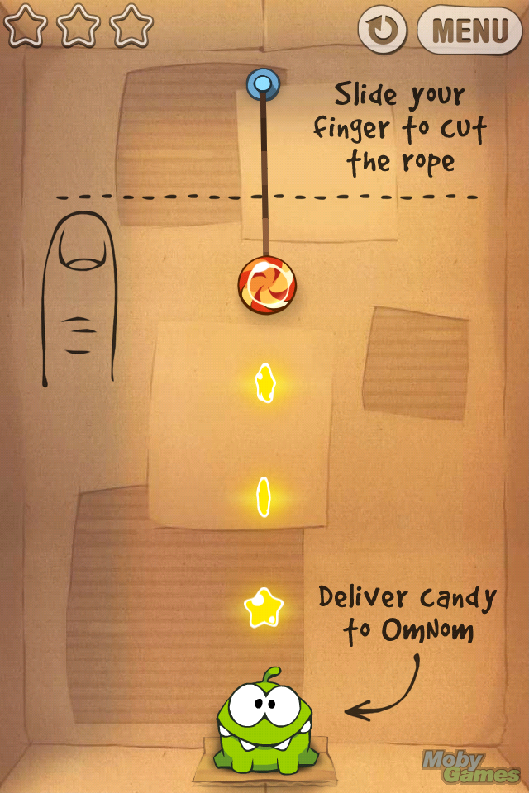
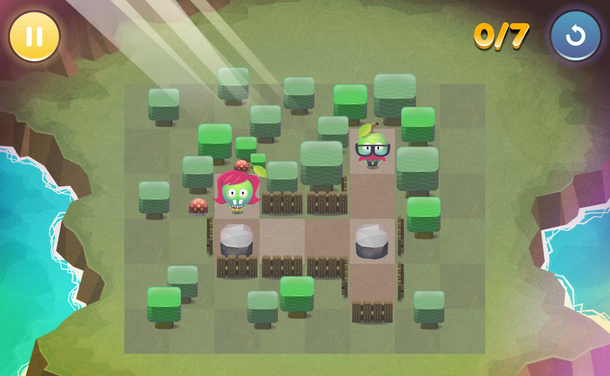
Literature Review
Research for Specific Games
  Sokoban
    Yoshio Murase et al.
    Taylor and Perry
  Cut the Rope
    Shaker et al.
  Fruit Dating
    Rychnovsky

Slide 10
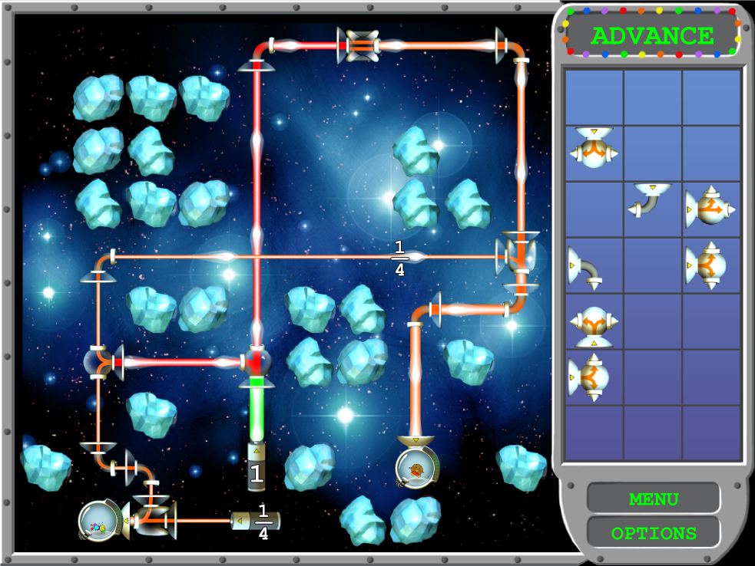
Literature Review
Generic Technique needs Specific Agent/Fitness Function
  Progressive Approach (Shaker et al.)
  Answer Set Programming (Smith et al.)

Slide 11
Level Generation
Methodology

Slide 12
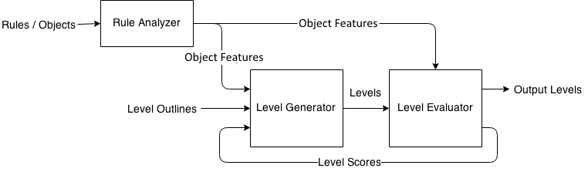
System Architecture

Slide 13
Rule Analyzer
Generate object features
Each object is assigned 6 different features
  Type
  Subtype
  Priority
  Behaviors
  Minimum Required Number
  Relations

Slide 14
Type
Based on object position in file
  Rule Object
  Player Object
  Winning Object
  Solid Object
[ > | ] -> [ > | > ]
Player
Crate
Player
Crate
All on
Target
Crate
Background
Target,
Player, Crate,
Spike
Wall

Slide 15
Subtype
Based on relation within rules
  Critical Object
  Normal Object
  Useless Object
[ > | ] -> [ > | > ]
[ | Gem | ] -> [ | | ]
[ > | ] -> [ | ]
[ > | ] -> [ | ]
No Target on Gem
Player
Crate
Player
Crate
Crate
Crate
Crate
Stopper
Crate
Stopper
Wife Lava

Slide 16
Priority
Number of Rules for each Object
[ > Player | Crate ] -> [ > Player | > Crate ]
[ > Crate | Crate ] -> [ > Crate | > Crate ]
[ Crate | Crate | Crate ] -> [ | | ]
[ > Crate | Stopper ] -> [ Crate | Stopper ]
All Player on Target
Crate | Player | Stopper | Target
4 | 2 | 1 | 1

Slide 17
Behaviors
Four different Behaviors
  Move
  Teleport
  Create
  Destroy
Objects can have more than one Behavior
[ > Player | Crate ] -> [ > Player | > Crate]
[ > Player | Crate ] -> [ Crate | Player ]
[ > Player | ] -> [ Crate | Player ]
[ > Player | Crate ] -> [ | Player ]

Slide 18
Minimum Required Number
Maximum number of an object in LHS of all rules
Minimum number of an object in Create rules
[ > Player | Crate ] -> [ > Player | > Crate ]
[ > Crate | Crate ] -> [ > Crate | > Crate ]
1
2
Crate Minimum Number: 2
[ > Player | ] -> [ Crate | Player ]
[ > Crate | Crate ] -> [ > Crate | > Crate ]
[ Gem | Crate | Gem ] -> [ Crate | Crate | Crate]
0
2
1
Crate Minimum Number: 0

Slide 19
Relations
List of all objects connected with a certain object
Special list for Left Hand Side (LHS)
[ > Player | Crate ] -> [ > Player | > Crate ]
[ > Crate | Lava ] -> [ | ]
All Target on Player
Player | Crate, Target
Crate | Player, Lava
Lava | Crate
Target | Player

Slide 20
System Architecture

Slide 21
Level Generator
Constructing a level from the input layout
Two different approaches
  Constructive Approach
  Genetic Approach

Slide 22
Constructive Approach
Uses an algorithm to generate levels
Algorithm utilizes object features
Algorithm is divided into two parts
  Calculating numbers
  Inserting objects

Slide 23
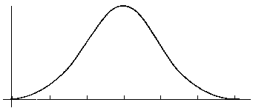
Calculating Numbers
Object numbers equals to its percentage in the game
Cover Percentage is inversely proportional to
  Critical objects percentage + Winning objects percentage
Boring
Frustration
Interesting
Winning and Critical Objects Percentages

Slide 24
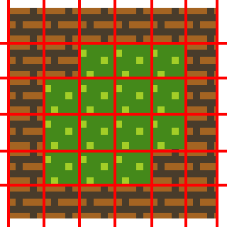
Inserting Objects
Based on Object Behaviors
  Move Behavior
  Others
Number of inserted objects are multiple of its Minimum Required Number feature
4
1
0

Slide 25
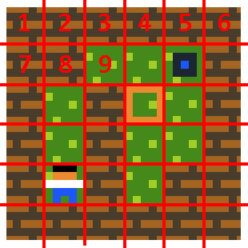
Genetic Approach
Uses Genetic Algorithm (GA)
Chromosome Representation

Slide 26
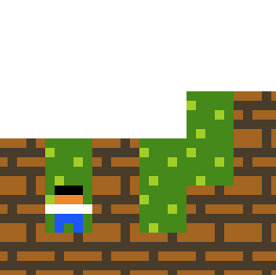
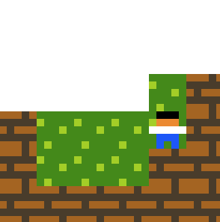
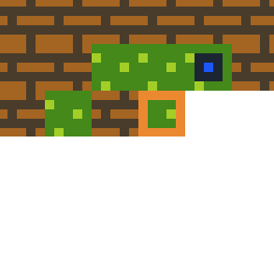
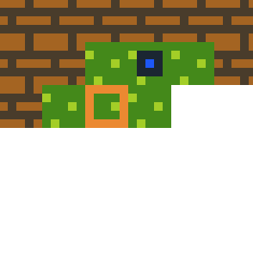
CrossOver
CrossOver Point
Chromosome 1
Chromosome 2

Slide 27
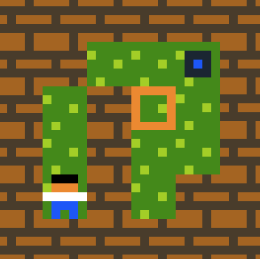


Mutation
Delete Mutator

Slide 28

Mutation
Create Mutator

Slide 29
Mutation
Swap Mutator

Slide 30
Initial Population
Random Initialization
Constructive Initialization
Hybrid Initialization
  25% Constructive Initialization
  25% Mutated Constructive Initialization
  50% Random Initialization

Slide 31
System Architecture

Slide 32
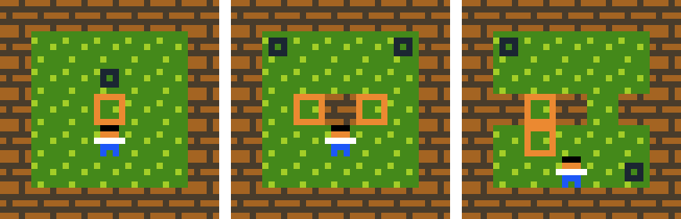
Level Evaluator
Evaluate Generated Levels
Use an Automated Player for Playability
Use Heuristics Measures for Challenging
All Solvable but differ in Challenge Level

Slide 33
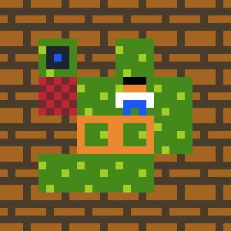
Automated Player
Enhanced Version of Lim et al. Automated Player
  BestFS Algorithm
Problem with Player as Winning Object
Explained in rules
[ > Player | Crate ] -> [ > Player | > Crate]
[ > Crate | Lava ] -> [ | ]
Player | Crate
Crate | Lava

Slide 34
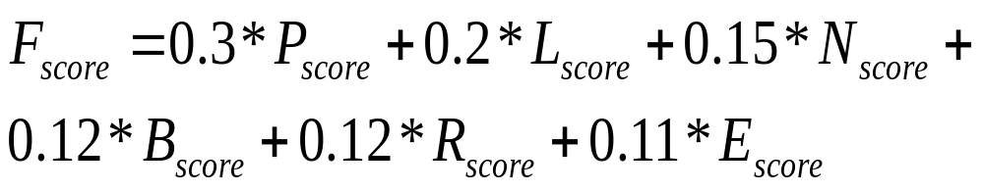
Heuristic Measures
Weighted Function of Six Attributes
Weights are calculated experimentally to ensure the best output

Slide 35

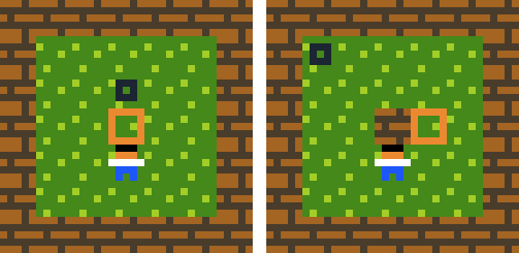
Playing Score (P_{score})
Difference between Best State Score and Initial Level Score
Inspired from Nielsen et al. work
Left Image Difference < Right Image Difference

Slide 36
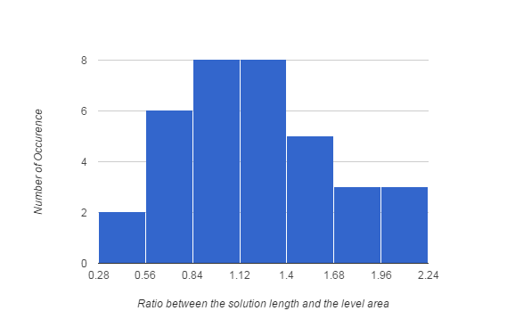
Solution Length Score (L_{score})
Ratio between solution length and level area
40 Hand Crafted Levels are Analyzed
Normal Distribution: μ = 1.221 and σ = 0.461

Slide 37
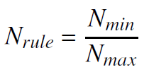
Object Number Score (N_{score})
Number of Rule Objects
Objects: Crate, Wall, Player, Target
Generated: Crate, Wall, Player
Score: 3 / 4

Slide 38

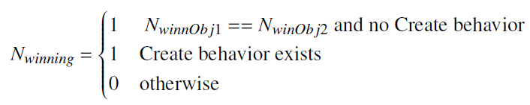
Object Number Score (N_{score})
Number of Players
Number of Winning Objects

Slide 39
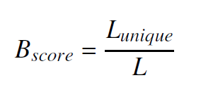
Box Line Score (B_{score})
Used in Taylor and Parberry research in generating Sokoban levels
, Up, Up, , Left, ,
Up
Left
Down
Left
Score: 4 / 7

Slide 40
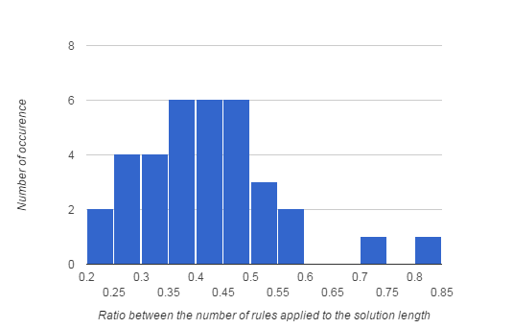
Applied Rule Score (R_{score})
Ratio between number of applied rules to solution length
40 Hand Crafted Levels are Analyzed
Normal Distribution: μ = 0.417 and σ = 0.128

Slide 41
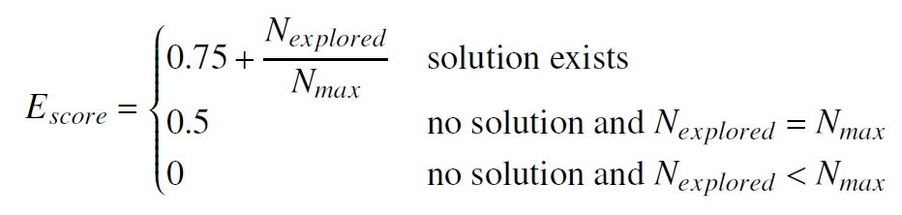
Exploration Score (E_{score})
More Exploration is More Challenging
Solution Matters

Slide 42
Level Generation
Results

Slide 43
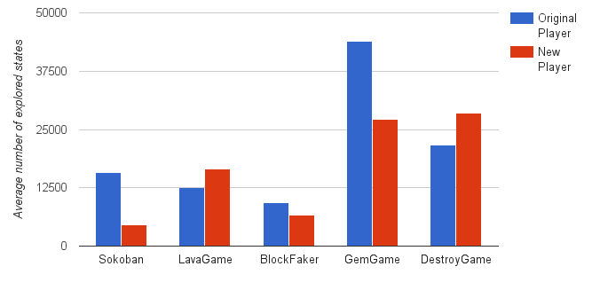
Automated Player Results
5 Different Games
  Covers Different Behaviors
New Player is better in all games except LavaGame and DestroyGame

Slide 44
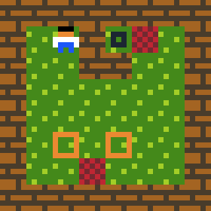
Automated Player Results
Destroy Behavior is core mechanic

Slide 45
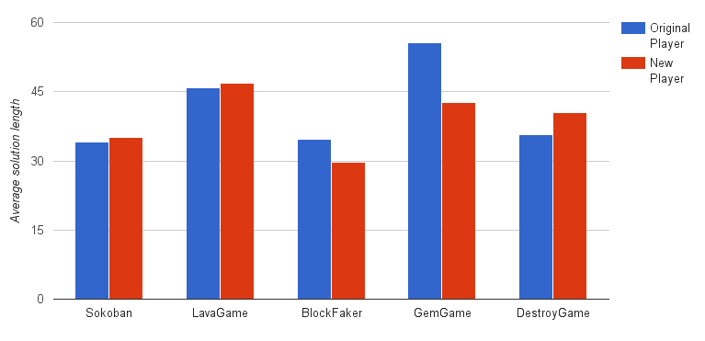
Automated Player Results
Average Solution Length

Slide 46
Level Generation Input
8 Different Layouts
  Different Sizes and Internal Structure
Automated Player is fixed to 5000 iteration
Constructive Approach
  100 Level Generated
  Best 2 Levels are selected
Genetic Approach
  50 Chromosome
  20 Generations
  70% CrossOver
  10% Mutation
  2% Elitism
  Best 2 Levels are selected

Slide 47
Level Generation Results
Constructive Approach
  90 % Playable Levels
Genetic Approach
  Random Initialization
    75% Playable Levels
  Constructive Initialization
    100% Playable Levels
  Hybrid Initialization
    100% Playable Levels

Slide 48
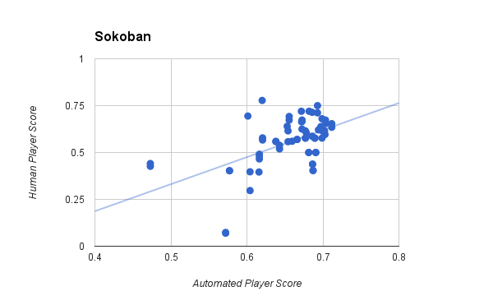
Level Generation Results
Human Feedback is collected on generated levels
74 Human Survey

Slide 49
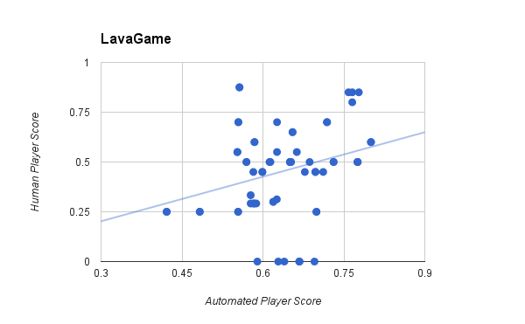
Level Generation Results
23 Human Survey

Slide 50
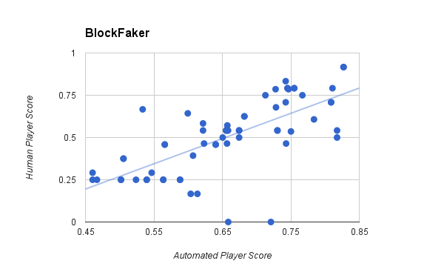
Level Generation Results
25 Human Survey

Slide 51
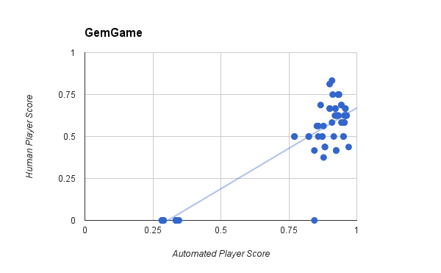
Level Generation Results
14 Human Survey

Slide 52
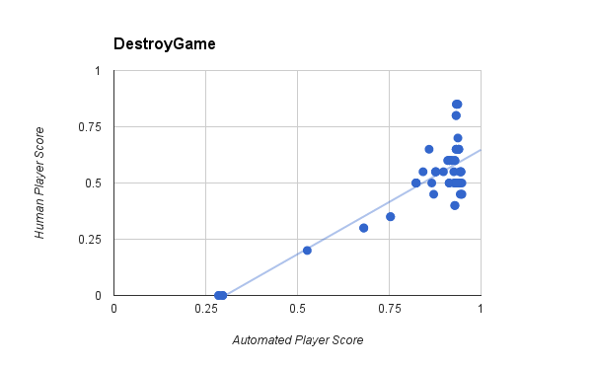
Level Generation Results
21 Human Survey

Slide 53
Level Generation Results
Correlation is not high
  Automated Player Score corresponds to Playability percentage
  Very Challenging Levels are rated High by system but Low by Humans
  Small Amount of collected human Data
  No Concise Definition of Good Level

Slide 54
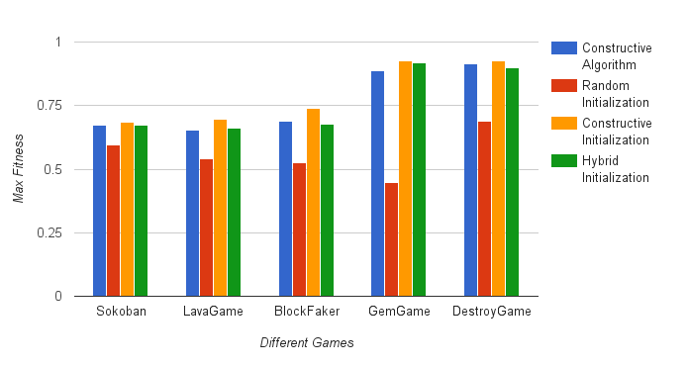
Level Generation Comparison

Slide 55
Rule Generation
Literature Review

Slide 56
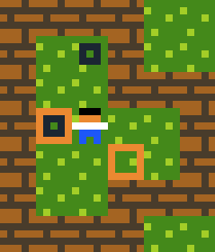
Literature Review
Lim et al. Work
  Generate PuzzleScript Rules
    Fixed Level
    Fixed Winning Condition
    4 Objects
  Used GA
    50 Generation, 50 Chromosomes
    Fitness (Rule Heuristic, Validity Score, Feasibility)
  Results
    Similar to Human Designed Rules (Push, Pull, Destroy, Create)
All Target on Crate

Slide 57
Rule Generation
Methodology

Slide 58
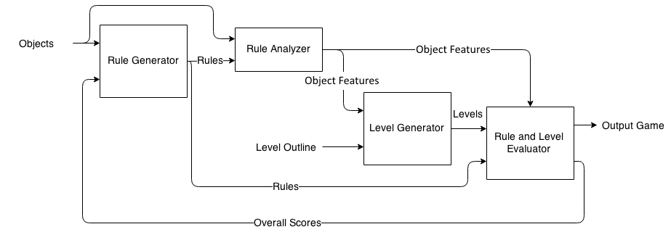
System Architecture

Slide 59
Rule Generator
Uses GA as in Lim et al. Work
Added Winning Condition
Chromosome Representation
  Group of rules of minimum 1 and maximum 4
  Winning Condition
[ > Player | Crate ] -> [ > Player | > Crate ]
[ > Crate | Crate ] -> [ > Crate | > Crate ]
All Target on Crate

Slide 60
CrossOver
Same Crossover in Lim et al. Work
Winning Condition CrossOver
All
Target on Crate
No
Target on Gem

Slide 61
Mutation
Same Mutation like Lim et al. Work
Winning Condition Mutator
All on Crate
Target
Gem

Slide 62
System Architecture

Slide 63

Rule and Level Evaluator
Combination between Level Evaluator and modified Lim et al. Evaluator
Weights are measured experimentally to ensure best results

Slide 64

Rule Score (R_{score})
Combination of Heuristics Score and Validity Score
Weights are measured experimentally to ensure best results
Validity Score is same like Lim et al. Work

Slide 65
Heuristics Score (H_{score})
Consists of Eight Heuristics
Four new Heuristic compared to Lim et al. Heuristics
All Heuristics have same weights

Slide 66
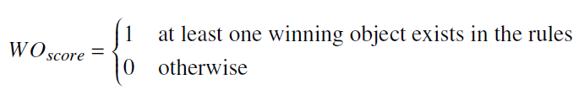
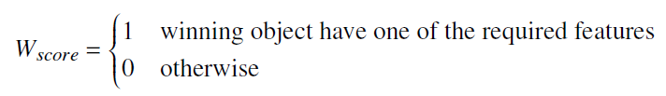
Heuristics Score (H_{score})
Winning Object in the Rules
Winning Condition Validity
All, Some | Create, Move, Teleport
No | Destroy, Move, Teleport

Slide 67

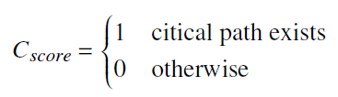
Heuristics Score (H_{score})
Useless Objects
Critical Path Exists
[ > Player | Crate ] -> [ > Player | > Crate ]
[ Crate | Crate | Crate ] -> [ | Gem | ]
Some Target on Gem

Slide 68
Rule Generation
Results

Slide 69
Input Description
4 Collision Layers with 8 Objects
Genetic Algorithm
  50 Chromosomes
  50 Generations
  65% Crossover
  10% Mutation
Automated Player
  Limited to 1500 iteration
Constructive Approach
  Generate 25 Levels
  Best 5 scores are averaged

Slide 70
No Restriction Results
No restriction on anything
Playable Games
[ action Player ] -> [ ^ Object4 ]
Some Object4 on Object1
....
Some Player on Object1

Slide 71
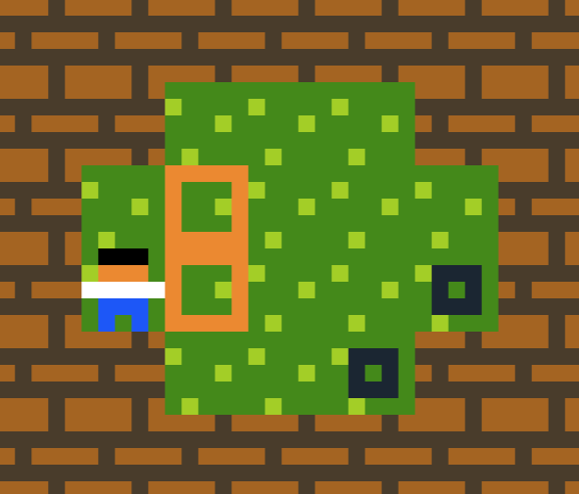
Fixed Level Results
Level is Fixed to Sokoban
Winnable Games
[ Object4 ] -> [ Object1 ]
.....
.....
All Object4 on Player

Slide 72
Fixed Winning Condition Results
Winning Condition is Fixed to Sokoban
Playable Games
All Object1 on Object4
[ Object1 | v Player ] -> [ | v Player ]

Slide 73
Fixed Playing Rules Results
Playing Rules are Fixed to Sokoban
Playable Games
[ > Player | Object4 ] -> [ > Player | > Object4 ]
All Object1 on Object4
No Object1 on Object4

Slide 74
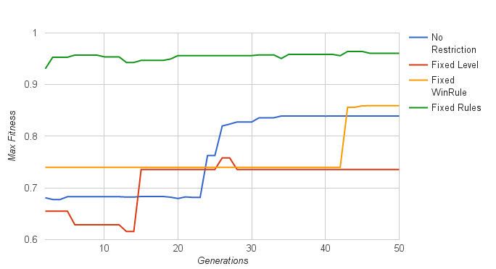
Score Comparison

Slide 75
Conclusion & Future Work

Slide 76
Conclusion
Constructive Approach
  90% Playable Levels
  Depend on Automated Player time
Genetic Approach
  100% Playable Levels
  Slower in generating levels

Slide 77
Conclusion
Initialization Methods:
  Constructive Initialization
    100% Playable
    Similar design to Constructive Approach
  Hybrid Initialization
    100% Playable
    Less similar to Constructive Approach
    Easier Levels
  Random Initialization
    75% Playable
    No Similarity to Constructive Approach
    Very Easy Levels

Slide 78
Conclusion
Rule Generation is possible without any restriction but needs long time
  Huge Search Space
Fixed Playing Rules Experiment is at best results
  Small Search Space

Slide 79
Future Work
Level Generation
  Better Model for Solution Length Score and Applied Rule Score (Weibull Distribution)
  Analyze Effect of each Heuristic Measure
  Analyze Search Space
  Generate Levels with Certain Difficulty
  Generate Levels with Certain Solution

Slide 80
Future Work
Rule Generation
  Generate Rules with specific Properties
  Understand Rule Generation Search Space
Automated Player
  Improve Time and Quality to decrease the Generation Time

Slide 81

Thank You

